Slide 1
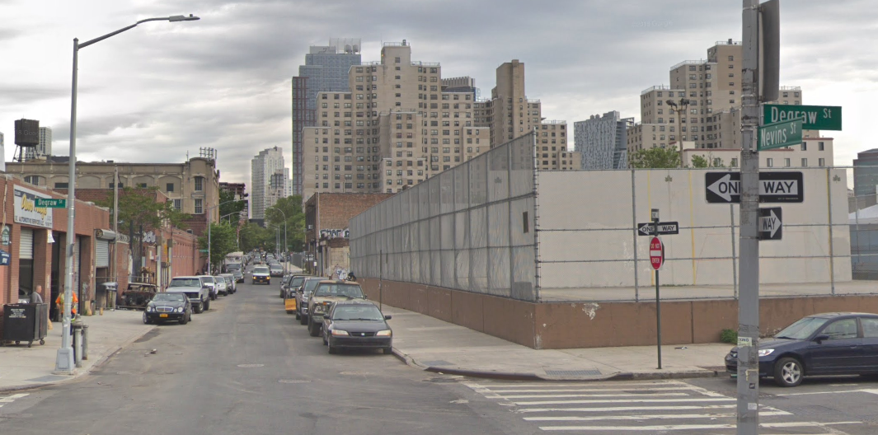
Gowanus Preliminary Traffic Analysis
DRAFT

Slide 2
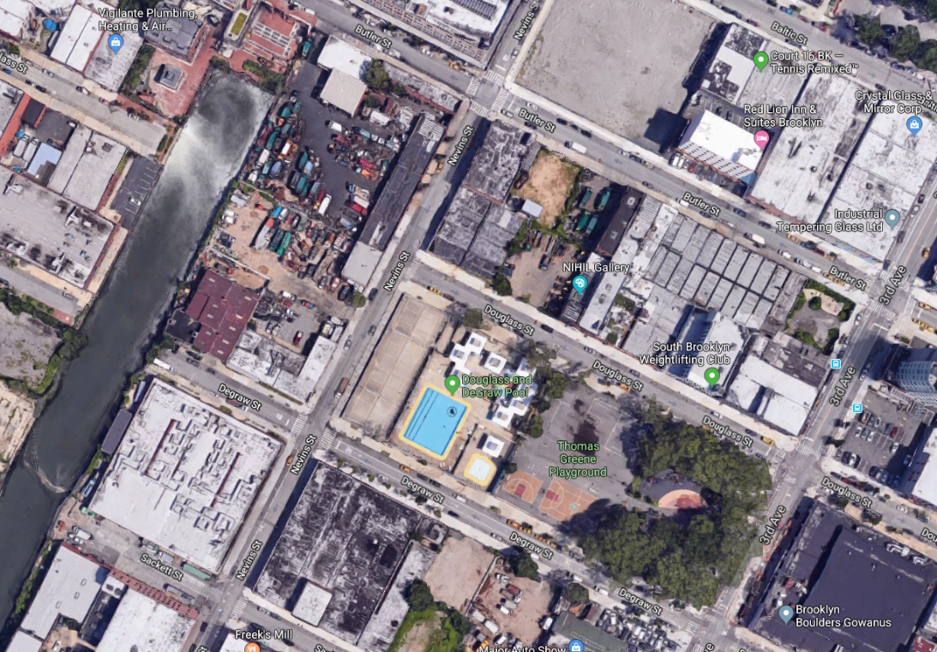
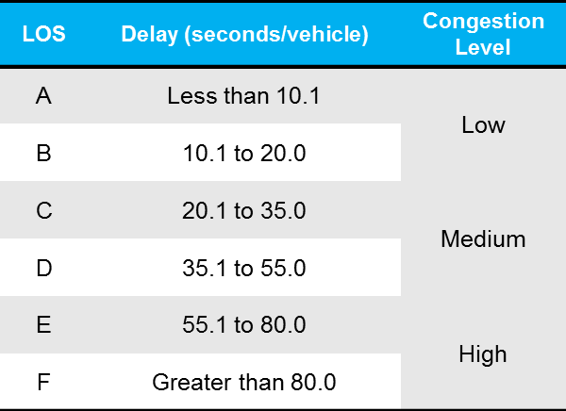
Introduction
The purpose of this analysis is to test how the closure of Nevins St between Douglass St and Degraw St for better connection between Thomas Greene Playground and waterfront site would affect the street network in Gowanus.
2 scenarios are analyzed for future Nevins Closure to test a range of different routes vehicles would take as alternatives:
Existing Condition
Future Scenario
With Improvements
Nevins Closure (50&50 Scenario)
Nevins Closure (Mixed Scenario)
Analysis Time Period:
Weekday AM Peak (Less Affected*)
Weekday PM Peak (Focus)
Intersection Level of Service (LOS) Definition:
Nevins St
Gowanus Canal
Douglass St
Thomas Greene Playground
Degraw St
* Traffic analyses are completed for the weekday AM peak but the results are only shown in the appendix simply because the street network will not be affected much by the closure due to the low volume (72 vehs/hr) of SB through traffic for Nevins St @ Douglass St during AM Peak.

Slide 3
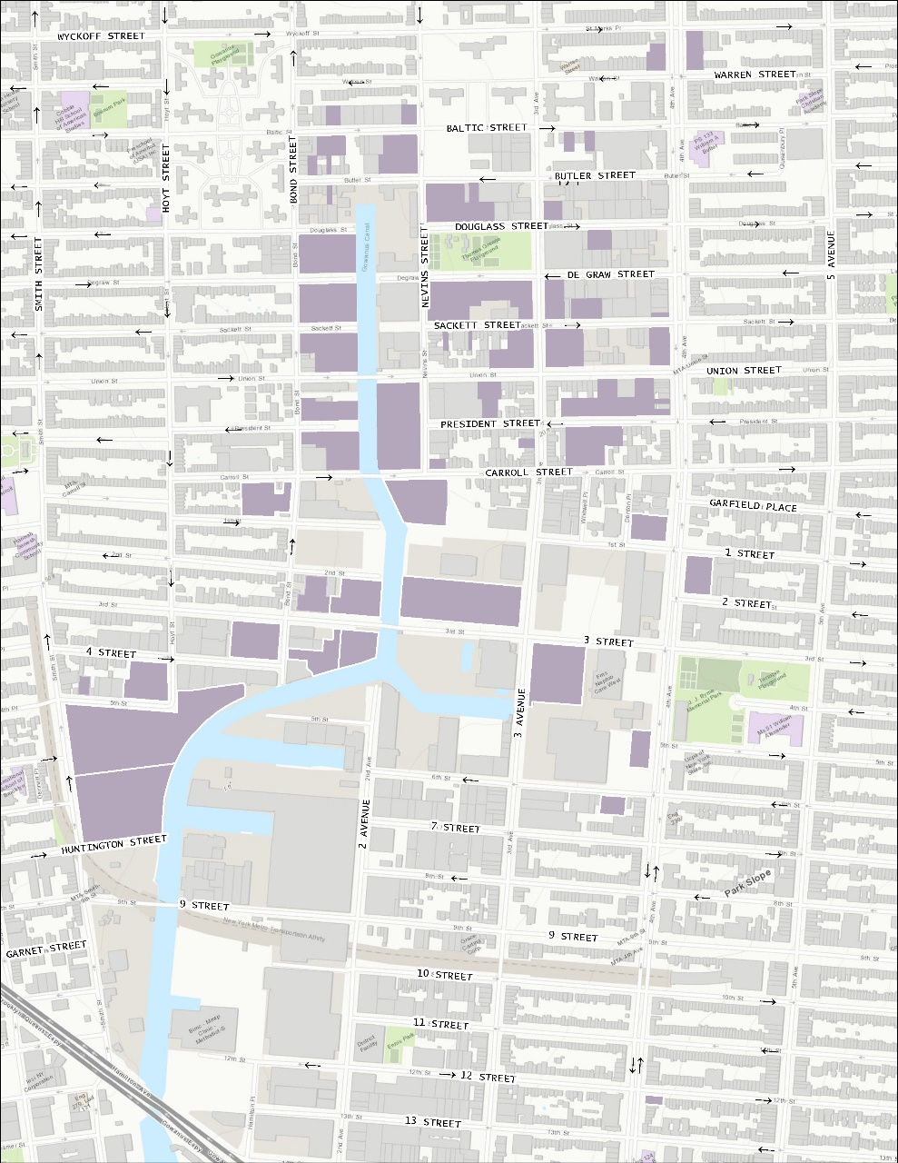
Existing Condition
Weekday PM Peak
19 signalized intersections, 3 unsignalized intersections, and 1 uncontrolled intersection
16 DEP traffic counts collected in 2016 and 7 DCP traffic counts collected in 2017
Focus on weekday PM peak for this analysis
Intersections with congested approaches:
4th Ave @ Union St (EB & WB)
4th Ave @ 3rd St (EB)
3rd Ave @ Union St (EB)
3rd Ave @ 9th St (WB)
C
B
B
B
A
B
B
F
F
B
E
C
C
B
C
D
B
F
C
C
C
B
B
B
E
C
C
Soft Sites
D
Intersection Level of Service
E
Congested Approach Level of Service

Slide 4
Future Scenario
Weekday PM Peak
With future background growth and projected land development after rezoning
Intersections with congested approaches:
4th Ave @ Union St (EB & WB)
4th Ave @ 3rd St (EB)
3rd Ave @ Union St (EB)
3rd Ave @ 3rd St (EB & WB & NB)
3rd Ave @ 6th St (WB)
3rd Ave @ 9th St (EB & WB)
Bond St @ Union St (EB)
Bond St @ 3rd St (EB)
Hoyt St @ Union St (EB)
Smith St @ 3rd St (NB)
C
B
B
B
A
B
B
E
E
F
F
C
F
D
D
B
D
F
E
D
F
F
F
F
F
E
F
D
E
B
C
B
E
E
C
C
Soft Sites
D
Intersection Level of Service
E
Congested Approach Level of Service

Slide 5
With Improvements
Weekday PM Peak
Improvements:
Change signal timings
Eliminate left turns
Daylight corners to add exclusive right-turn lanes
Divert 25% 3rd St EB traffic to Union St
Intersections with congested approaches:
4th Ave @ 3rd St (EB & SB)
3rd Ave @ 3rd St (EB & NB & SB)
Bond St @ Union St (EB)
Bond St @ 3rd St (EB)
C
B
B
B
A
B
B
E
C
D
D
D
C
C
E
E
E
D
E
E
E
D
E
D
C
C
B
C
C
Soft Sites
D
Intersection Level of Service
E
Congested Approach Level of Service

Slide 6
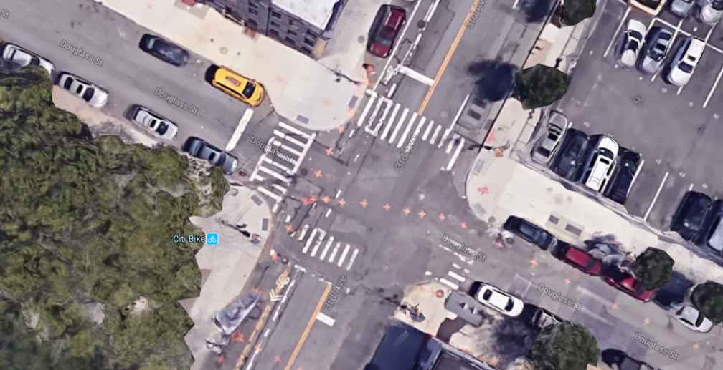
Nevins Closure (50&50 Scenario)
Weekday PM Peak
D
Intersection Level of Service
E
Congested Approach Level of Service
Closing Nevins St between Douglass St and Degraw St will require redirecting 280 vehs/hr SB through traffic for Nevins St @ Douglass St during PM peak in the future With Improvements scenario.
The 50&50 Scenario assumes in the future:
50% of vehicles will zigzag (Nevins=>Douglass=>3rd=>Degraw=>Nevins).
50% of vehicles will use 3rd Ave (3rd=>Degraw=>Nevins).
3rd Ave @ Douglass St EB will need improvements due to the street closure:
Daylight SW corner to add an EB exclusive right-turn lane.
Assumed Future Traffic Flow
NEVINS
STREET
3RD
AVE
4TH
AVE
C
50%
50%
B
B
DOUGLASS
STREET
B
B
B
B
C
D
D
3rd Ave
Douglass St
Daylighting for 3rd Ave @ Douglass St

Slide 7
Nevins Closure (Mixed Scenario)
Weekday PM Peak
D
Intersection Level of Service
E
Congested Approach Level of Service
Closing Nevins St between Douglass St and Degraw St will require redirecting 280 vehs/hr SB through traffic for Nevins St @ Douglass St during PM peak in the future With Improvements scenario.
The Mixed Scenario first made assumptions on the current traffic flow based on the traffic data, development scenario, and origin-destination data:
11% is accessing sites along Nevins St
30% is ultimately turning to 3rd Ave to head south
25% is going east along Sackett St
34% is heading east through Union St and Carroll St
Assumed Current Traffic Flow
NEVINS
STREET
3RD
AVE
4TH
AVE
C
100%
B
B
B
25%
B
B
2%
2%
25%
SACKETT
STREET
B
13%
UNION
STREET
C
D
D
2%
1%
6%
12%
CARROLL
STREET
22%
4%
11%
11%
30%
34%

Slide 8
Nevins Closure (Mixed Scenario)
Weekday PM Peak
D
Intersection Level of Service
E
Congested Approach Level of Service
Based on the assumptions of current traffic flow, vehicles will be redirected to different routes:
11% will zigzag to access sites along Nevins St (Nevins=>Douglass=>3rd=>Degraw=>Nevins)
30% will use 3rd Ave to head south instead of through Nevins St
25% will turn to east from Nevins St along Douglass St instead of Sackett St
34% will make left turns at various intersections (Sackett St, Union St, Carroll St, and 1st St) on 4th Ave to head east
3rd Ave @ Douglass St EB will need improvements due to the street closure:
Daylight SW corner to add an EB exclusive right-turn lane
Assumed Future Traffic Flow
NEVINS
STREET
3RD
AVE
4TH
AVE
C
30%
34%
11%
25%
B
25%
DOUGLASS
STREET
B
B
A
B
2%
2%
10%
SACKETT
STREET
B
UNION
STREET
C
D
D
2%
1%
4%
10%
4%
30%
10%
1ST
STREET

Slide 9
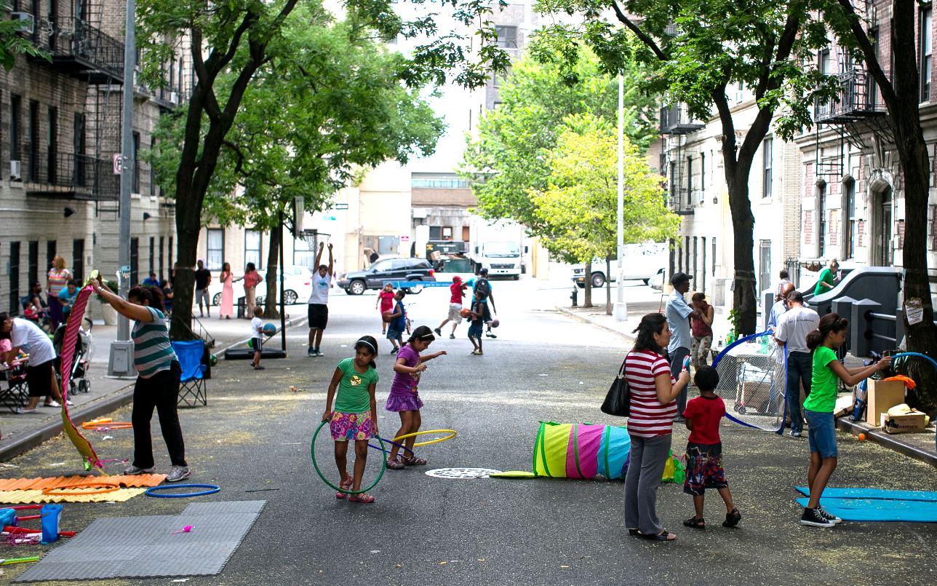
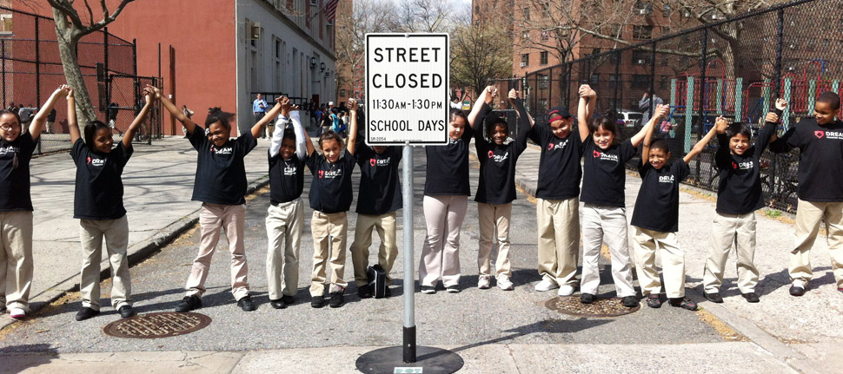
Conclusion
Weekday PM Peak is the most critical time period.
There are lower traffic volumes on Nevins during Weekday AM Peak compared to Weekday PM Peak.
No Weekday Midday or Weekend data is available for DEP traffic counts, but in general there are lower traffic volumes during those two periods within the study area based on DCP traffic counts.
3rd Ave @ Douglass St is the most affected intersection by the Nevins closure.
Needs improvements such as daylighting.
Some other intersections might also be affected, especially left turns on 4th Ave, in addition to the intersections analyzed.
The Nevins closure is generally feasible, but the benefit gained for pedestrian may not necessarily beat the impact on traffic.
Side streets around Thomas Greene Playground (especially Douglass St) may suffer from extra traffic, which will also affect the user experience of the park.
Alternatives like temporary closure on weekends, Play Streets, shared street, or other traffic calming options might be preferred.
Closure should happen after the reconstruction of the playground and the redevelopment of the waterfront site.
Harvest Home Play Streets
School Play Streets
Play Streets: https://www1.nyc.gov/site/doh/health/health-topics/play-streets.page

Slide 10
Appendix
Technical Details

Slide 11
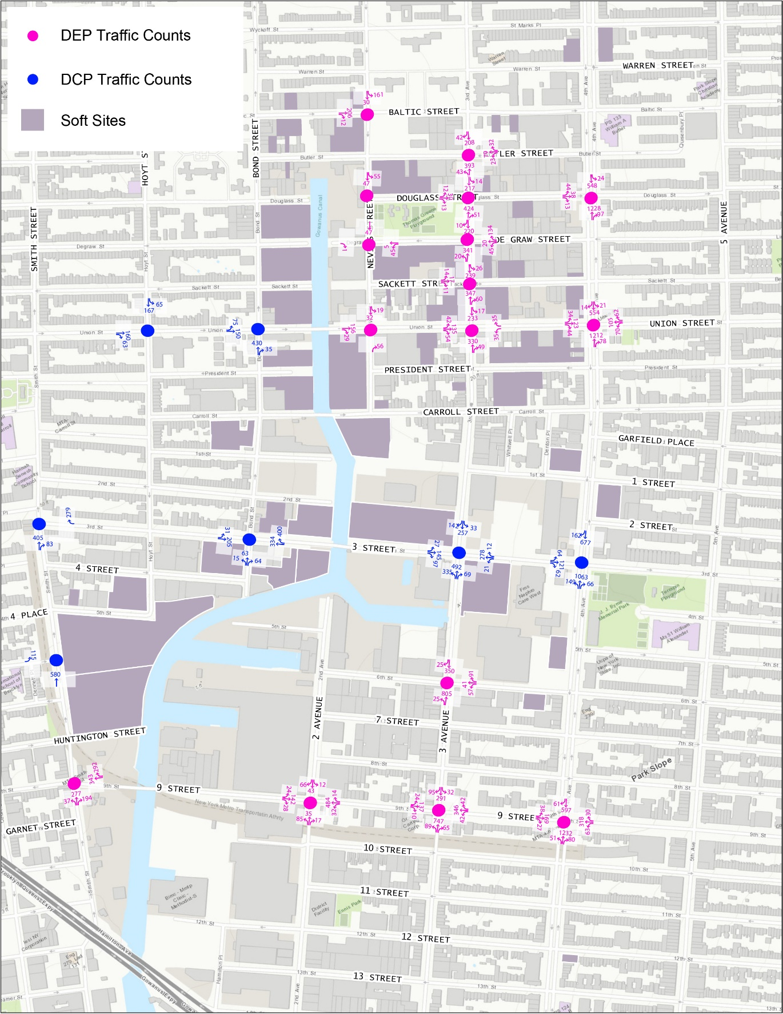

Existing Condition – Traffic Volume
Weekday AM Peak
Weekday PM Peak

Slide 12
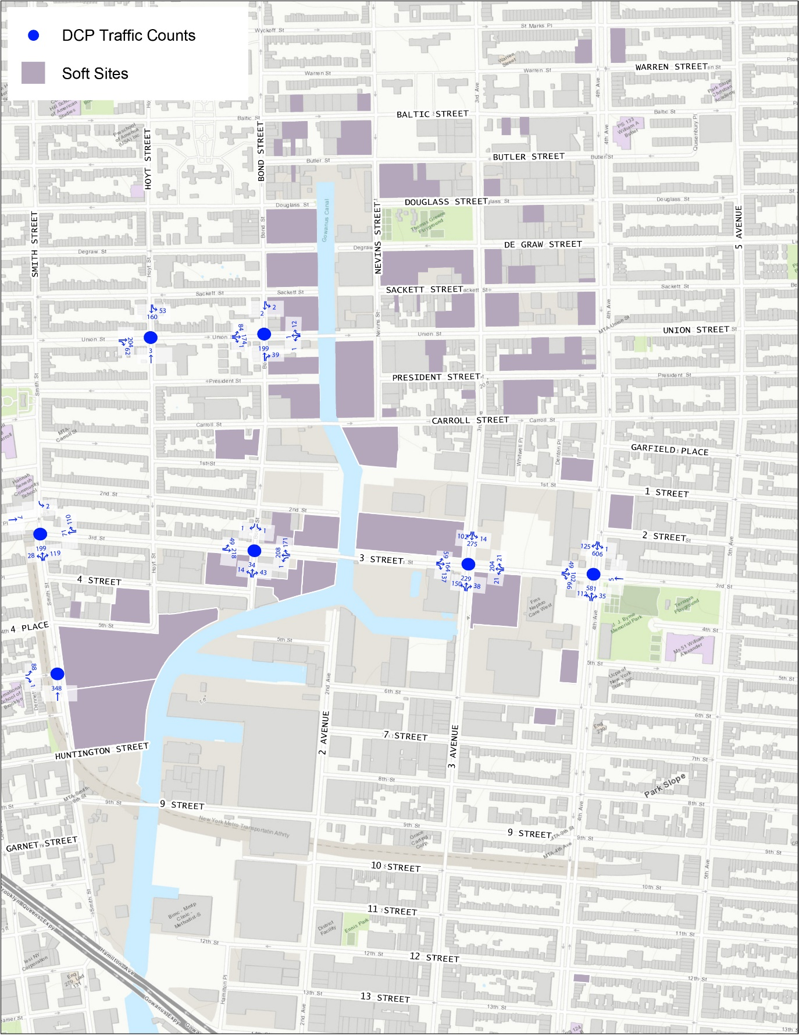
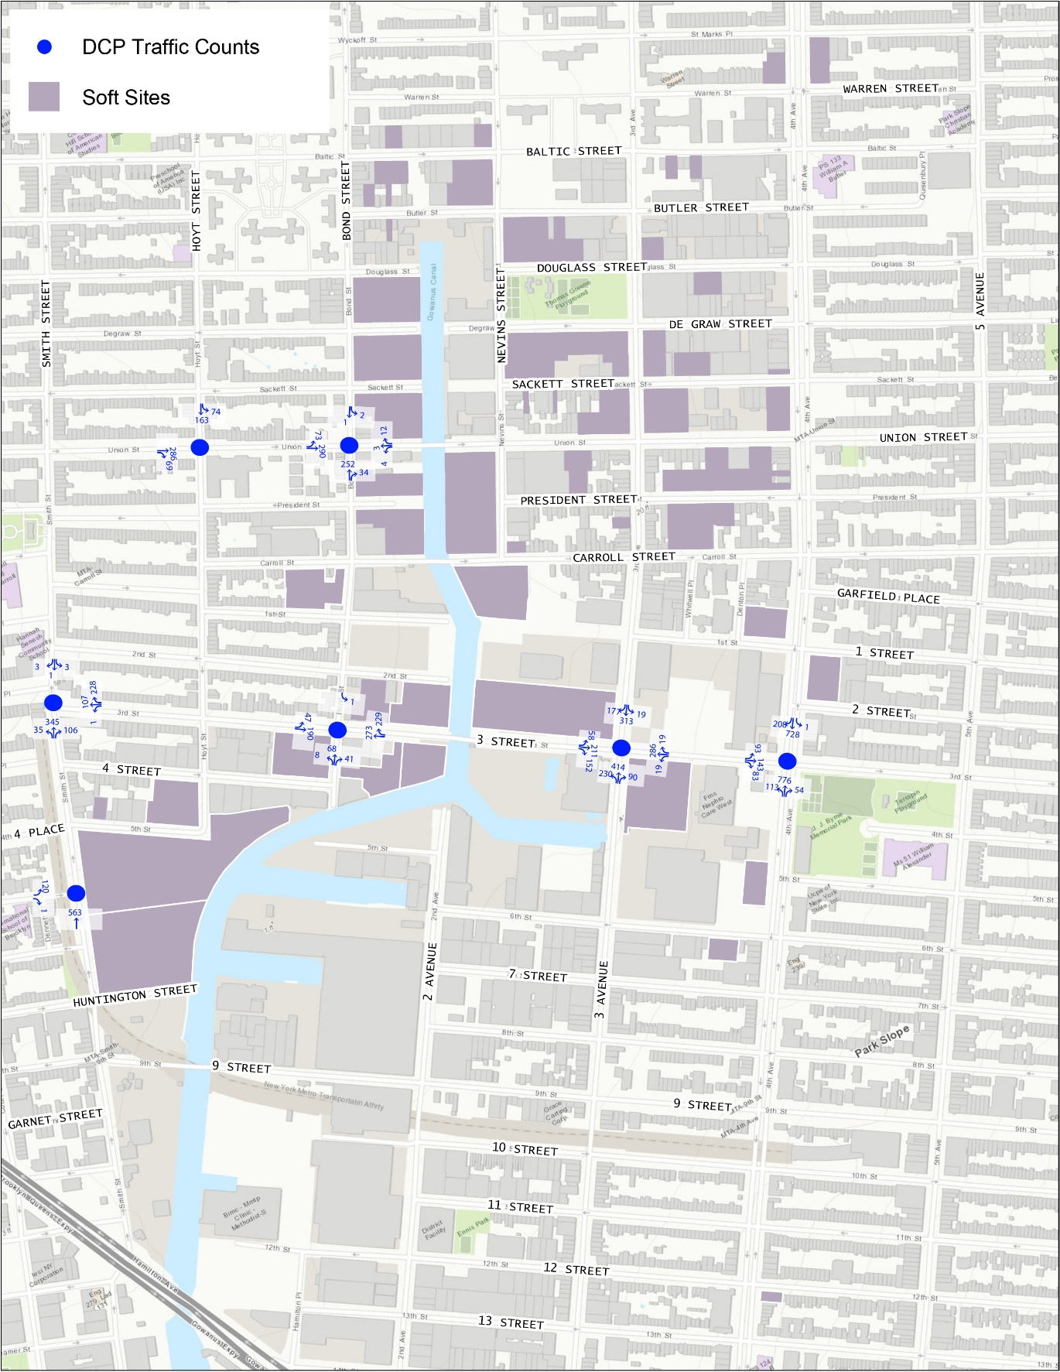
Existing Condition – Traffic Volume
Weekday Midday Peak
Saturday Midday Peak

Slide 13
Existing Condition – AM LOS
Weekday AM Peak
Intersection | Eastbound |  |  | Westbound |  |  | Northbound |  |  | Southbound
 | Left | Through | Right | Left | Through | Right | Left | Through | Right | Left | Through | Right
4th Ave @ Douglass St (Signalized) | C* (0.18)** |  | C (0.03) | - |  |  | - | B (0.69) |  | C (0.26) | B (0.42) | -
4th Ave @ Union St (Signalized) | D (0.77) |  |  | F (0.97) |  |  | - | A (0.55) |  | B (0.16) | B (0.32)
4th Ave @ 3rd St (Signalized) | D (0.74) |  |  | - |  |  | B (0.45) | A (0.63) |  | - | C (0.63)
4th Ave @ 9th St (Signalized) | D (0.42) | D (0.42) | C (0.09) | D (0.30) | D (0.71) | D (0.38) | B (0.16) | B (0.76) |  | - | C (0.56)
3rd Ave @ Butler St (Signalized) | - |  |  | C (0.30) |  |  | B (0.39) |  | - | - | C (0.45)
3rd Ave @ Douglass St (Signalized) | C (0.10) |  |  | - |  |  | - | B (0.37) |  | C (0.40) |  | -
3rd Ave @ Degraw St (Signalized) | - |  |  | C (0.54) |  |  | B (0.27) |  | - | - | B (0.36)
3rd Ave @ Sackett St (Signalized) | C (0.11) |  |  | - |  |  | - | B (0.30) |  | B (0.42) |  | -
3rd Ave @ Union St (Signalized) | D (0.61) |  |  | D (0.44) | C (0.12) |  | - | B (0.47) |  | B (0.31) |  | -
3rd Ave @ 3rd St (Signalized) | D (0.37) | D (0.70) |  | F (1.03) |  |  | C (0.76) | A (0.64) |  | A (0.10) | B (0.42)
3rd Ave @ 6th St (Signalized) | - |  |  | E (0.74) |  |  | A (0.47) |  | - | - | B (0.42)
3rd Ave @ 9th St (Signalized) | E (0.52) | D (0.42) |  | D (0.23) | F (0.95) | D (0.17) | B (0.24) | A (0.46) |  | B (0.16) | B (0.46)
Nevins St @ Baltic St (Unsignalized) | B (0.36) |  |  | - |  |  | - |  |  | B (0.32)
Nevins St @ Degraw St (Unsignalized) | A (0.00) |  |  | A (0.08) |  |  | - |  |  | A (0.07)
Nevins St @ Union St (Signalized) | - | A (0.34) |  | - |  |  | - |  | B (0.17) | B (0.14) |  | -
2nd Ave @ 9th St (Signalized) | B (0.20) | B (0.32) |  | B (0.12) | C (0.81) |  | B (0.37) |  |  | B (0.28)
Bond St @ Union St (Signalized) | C (0.69) |  | - | - |  |  | - | B (0.70) |  | -
Bond St @ 3rd St (Signalized) | B (0.43) |  | - | - | B (0.45) | C (0.89) | B (0.38) |  |  | -
Hoyt St @ Union St (Signalized) | - | C (0.69) |  | - |  |  | - |  |  | B (0.45) |  | -
Smith St @ 3rd St (Signalized) | - |  |  | - |  | E (0.99) | - | E (1.01) |  | -
Smith St @ Luquer St (Unsignalized) | D (0.43) |  |  | - |  |  | - |  |  | -
Smith St @ 9th St (Signalized) | - |  |  | - | B (0.72) | D (0.84) | B (0.57) |  | C (0.60) | -
B
B
B
B
A
B
B
C
F
B
C
B
C
E
E
E
C
C
F
B
D
E
B
C
B
E
C
C
Soft Sites
D
Intersection Level of Service
* Lane Group Level of Service (Signalized) / Total Lane Level of Service (Unsignalized)
** Lane Group v/c Ratio (Signalized) / Degree of Utilization (Unsignalized)
E
Congested Approach Level of Service

Slide 14
Existing Condition – PM LOS
Weekday PM Peak
Intersection | Eastbound |  |  | Westbound |  |  | Northbound |  |  | Southbound
 | Left | Through | Right | Left | Through | Right | Left | Through | Right | Left | Through | Right
4th Ave @ Douglass St (Signalized) | D* (0.42)** |  | C (0.21) | - |  |  | - | B (0.53) |  | B (0.22) | A (0.55) | -
4th Ave @ Union St (Signalized) | E (0.88) |  |  | F (0.98) |  |  | - | B (0.57) |  | B (0.17) | A (0.56)
4th Ave @ 3rd St (Signalized) | F (0.97) |  |  | - |  |  | B (0.48) | B (0.57) |  | - | B (0.80)
4th Ave @ 9th St (Signalized) | D (0.48) | D (0.56) | D (0.31) | D (0.63) | D (0.57) | D (0.37) | C (0.15) | C (0.71) |  | - | C (0.79)
3rd Ave @ Butler St (Signalized) | - |  |  | D (0.57) |  |  | B (0.60) |  | - | - | A (0.44)
3rd Ave @ Douglass St (Signalized) | D (0.44) |  |  | - |  |  | - | B (0.53) |  | A (0.42) |  | -
3rd Ave @ Degraw St (Signalized) | - |  |  | D (0.38) |  |  | B (0.50) |  | - | - | A (0.38)
3rd Ave @ Sackett St (Signalized) | D (0.49) |  |  | - |  |  | - | B (0.57) |  | A (0.51) |  | -
3rd Ave @ Union St (Signalized) | F (1.00) |  |  | D (0.55) | C (0.12) |  | - | B (0.54) |  | A (0.39) |  | -
3rd Ave @ 3rd St (Signalized) | D (0.38) | E (0.89) |  | D (0.66) |  |  | D (0.86) | C (0.83) |  | B (0.18) | B (0.63)
3rd Ave @ 6th St (Signalized) | - |  |  | D (0.50) |  |  | B (0.39) |  | - | - | A (0.72)
3rd Ave @ 9th St (Signalized) | D (0.39) | D (0.71) |  | D (0.39) | E (0.76) | D (0.09) | B (0.13) | B (0.39) |  | B (0.28) | A (0.51)
Nevins St @ Baltic St (Unsignalized) | B (0.56) |  |  | - |  |  | - |  |  | C (0.62)
Nevins St @ Degraw St (Unsignalized) | A (0.01) |  |  | A (0.05) |  |  | - |  |  | A (0.31)
Nevins St @ Union St (Signalized) | - | B (0.52) |  | - |  |  | - |  | B (0.10) | B (0.35) |  | -
2nd Ave @ 9th St (Signalized) | B (0.09) | B (0.41) |  | B (0.07) | B (0.56) |  | B (0.32) |  |  | B (0.37)
Bond St @ Union St (Signalized) | D (0.89) |  | - | - |  |  | - | B (0.71) |  | -
Bond St @ 3rd St (Signalized) | B (0.64) |  | - | - | A (0.37) | B (0.70) | B (0.41) |  |  | -
Hoyt St @ Union St (Signalized) | - | D (0.95) |  | - |  |  | - |  |  | B (0.62) |  | -
Smith St @ 3rd St (Signalized) | - |  |  | - |  | C (0.68) | - | D (0.94) |  | -
Smith St @ Luquer St (Unsignalized) | C (0.29) |  |  | - |  |  | - |  |  | -
Smith St @ 9th St (Signalized) | - |  |  | - | B (0.61) | B (0.33) | C (0.64) |  | C (0.71) | -
C
B
B
B
A
B
B
F
F
B
E
C
C
B
C
D
B
F
C
C
C
B
B
B
E
C
C
Soft Sites
D
Intersection Level of Service
* Lane Group Level of Service (Signalized) / Total Lane Level of Service (Unsignalized)
** Lane Group v/c Ratio (Signalized) / Degree of Utilization (Unsignalized)
E
Congested Approach Level of Service

Slide 15
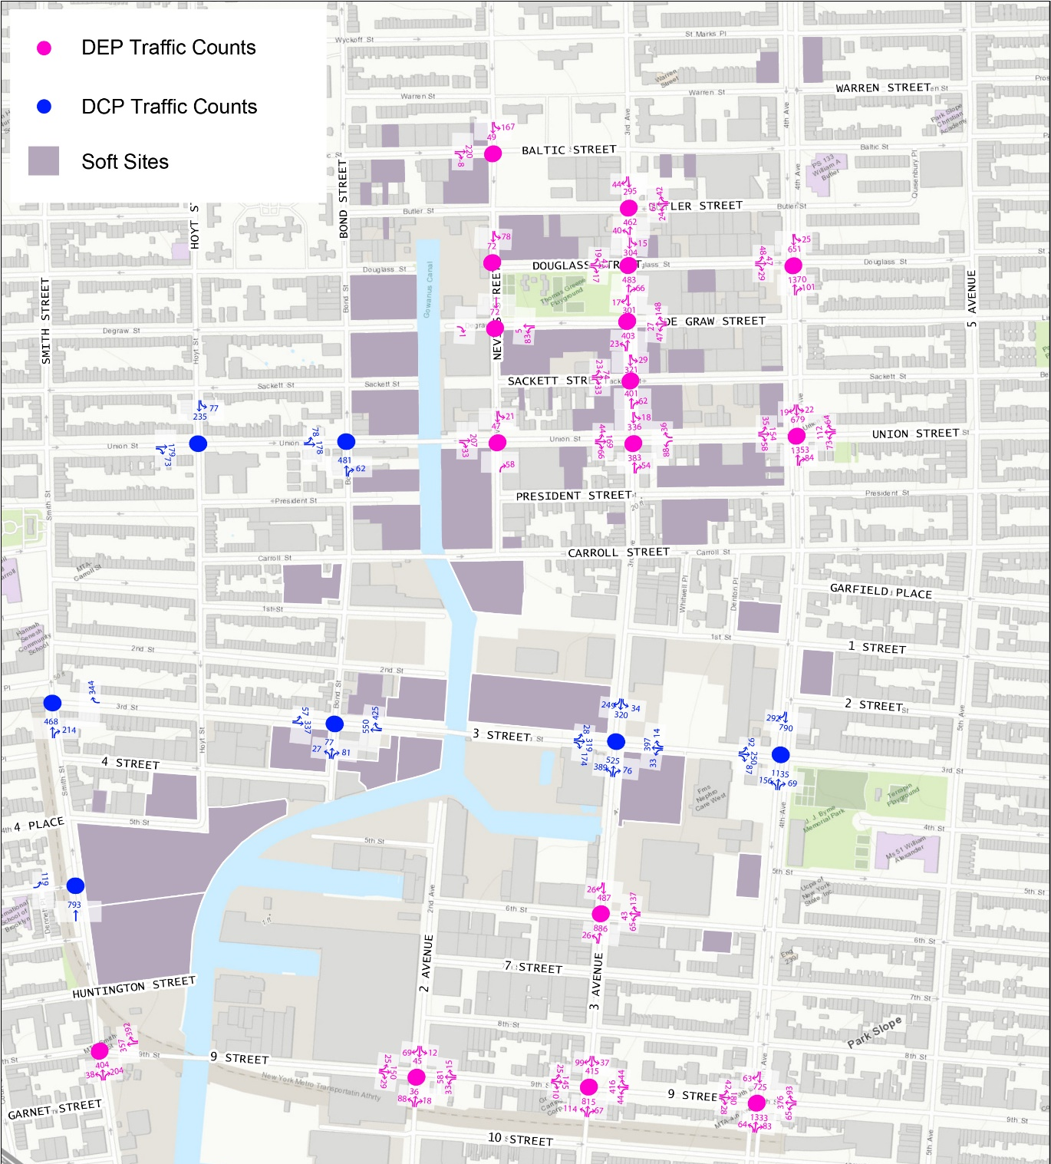

Future Scenario – Traffic Volume
Weekday AM Peak
Weekday PM Peak

Slide 16
Future Scenario – AM LOS
Weekday AM Peak
Intersection | Eastbound |  |  | Westbound |  |  | Northbound |  |  | Southbound
 | Left | Through | Right | Left | Through | Right | Left | Through | Right | Left | Through | Right
4th Ave @ Douglass St (Signalized) | C* (0.20)** |  | C (0.07) | - |  |  | - | B (0.76) |  | C (0.34) | B (0.49) | -
4th Ave @ Union St (Signalized) | E (0.94) |  |  | F (1.11) |  |  | - | A (0.61) |  | B (0.20) | B (0.40)
4th Ave @ 3rd St (Signalized) | F (1.27) |  |  | - |  |  | C (0.59) | A (0.67) |  | - | C (0.83)
4th Ave @ 9th St (Signalized) | E (0.62) | D (0.44) | C (0.10) | D (0.32) | E (0.84) | D (0.39) | C (0.22) | B (0.81) |  | - | C (0.67)
3rd Ave @ Butler St (Signalized) | - |  |  | C (0.29) |  |  | B (0.45) |  | - | - | C (0.60)
3rd Ave @ Douglass St (Signalized) | C (0.14) |  |  | - |  |  | - | B (0.43) |  | C (0.56) |  | -
3rd Ave @ Degraw St (Signalized) | - |  |  | D (0.60) |  |  | B (0.32) |  | - | - | B (0.50)
3rd Ave @ Sackett St (Signalized) | C (0.32) |  |  | - |  |  | - | B (0.34) |  | C (0.55) |  | -
3rd Ave @ Union St (Signalized) | D (0.74) |  |  | D (0.50) | C (0.12) |  | - | B (0.53) |  | B (0.43) |  | -
3rd Ave @ 3rd St (Signalized) | E (0.58) | F (1.39) |  | F (5.28) |  |  | F (1.23) | A (0.69) |  | A (0.11) | B (0.61)
3rd Ave @ 6th St (Signalized) | - |  |  | F (0.97) |  |  | A (0.51) |  | - | - | B (0.57)
3rd Ave @ 9th St (Signalized) | E (0.55) | D (0.44) |  | D (0.25) | F (1.14) | D (0.18) | B (0.40) | A (0.50) |  | B (0.20) | B (0.60)
Nevins St @ Baltic St (Unsignalized) | B (0.37) |  |  | - |  |  | - |  |  | B (0.37)
Nevins St @ Degraw St (Unsignalized) | A (0.00) |  |  | A (0.14) |  |  | - |  |  | A (0.11)
Nevins St @ Union St (Signalized) | - | B (0.44) |  | - |  |  | - |  | B (0.18) | B (0.19) |  | -
2nd Ave @ 9th St (Signalized) | B (0.24) | B (0.34) |  | B (0.12) | D (0.97) |  | B (0.38) |  |  | B (0.29)
Bond St @ Union St (Signalized) | C (0.78) |  | - | - |  |  | - | C (0.84) |  | -
Bond St @ 3rd St (Signalized) | C (0.84) |  | - | - | B (0.74) | D (0.95) | C (0.50) |  |  | -
Hoyt St @ Union St (Signalized) | - | C (0.78) |  | - |  |  | - |  |  | B (0.60) |  | -
Smith St @ 3rd St (Signalized) | - |  |  | - |  | F (1.22) | - | F (1.52) |  | -
Smith St @ Luquer St (Unsignalized) | E (0.62) |  |  | - |  |  | - |  |  | -
Smith St @ 9th St (Signalized) | - |  |  | - | C (0.80) | F (1.13) | C (0.79) |  | C (0.63) | -
B
C
B
B
A
C
B
E
C
F
C
C
B
C
F
F
F
C
F
F
F
F
D
E
E
E
C
F
D
E
C
D
F
C
Soft Sites
D
Intersection Level of Service
* Lane Group Level of Service (Signalized) / Total Lane Level of Service (Unsignalized)
** Lane Group v/c Ratio (Signalized) / Degree of Utilization (Unsignalized)
E
Congested Approach Level of Service

Slide 17
Future Scenario – PM LOS
Weekday PM Peak
Intersection | Eastbound |  |  | Westbound |  |  | Northbound |  |  | Southbound
 | Left | Through | Right | Left | Through | Right | Left | Through | Right | Left | Through | Right
4th Ave @ Douglass St (Signalized) | D* (0.46)** |  | C (0.26) | - |  |  | - | B (0.58) |  | B (0.27) | A (0.60) | -
4th Ave @ Union St (Signalized) | F (0.99) |  |  | F (1.12) |  |  | - | B (0.62) |  | B (0.21) | A (0.63)
4th Ave @ 3rd St (Signalized) | F (1.47) |  |  | - |  |  | C (0.60) | B (0.62) |  | - | C (0.94)
4th Ave @ 9th St (Signalized) | D (0.58) | D (0.61) | D (0.32) | E (0.71) | D (0.68) | D (0.38) | C (0.20) | C (0.77) |  | - | C (0.87)
3rd Ave @ Butler St (Signalized) | - |  |  | D (0.69) |  |  | B (0.69) |  | - | - | A (0.56)
3rd Ave @ Douglass St (Signalized) | D (0.44) |  |  | - |  |  | - | B (0.53) |  | A (0.42) |  | -
3rd Ave @ Degraw St (Signalized) | - |  |  | D (0.47) |  |  | B (0.58) |  | - | - | A (0.46)
3rd Ave @ Sackett St (Signalized) | D (0.49) |  |  | - |  |  | - | B (0.64) |  | A (0.61) |  | -
3rd Ave @ Union St (Signalized) | F (1.11) |  |  | E (0.65) | C (0.12) |  | - | B (0.62) |  | A (0.45) |  | -
3rd Ave @ 3rd St (Signalized) | D (0.54) | F (1.26) |  | F (1.41) |  |  | F (1.42) | D (0.94) |  | B (0.28) | B (0.75)
3rd Ave @ 6th St (Signalized) | - |  |  | E (0.72) |  |  | B (0.44) |  | - | - | B (0.86)
3rd Ave @ 9th St (Signalized) | E (0.56) | E (0.74) |  | D (0.43) | E (0.91) | D (0.10) | B (0.24) | B (0.44) |  | B (0.38) | B (0.60)
Nevins St @ Baltic St (Unsignalized) | B (0.55) |  |  | - |  |  | - |  |  | C (0.70)
Nevins St @ Degraw St (Unsignalized) | A (0.01) |  |  | A (0.06) |  |  | - |  |  | A (0.37)
Nevins St @ Union St (Signalized) | - | B (0.64) |  | - |  |  | - |  | B (0.10) | B (0.44) |  | -
2nd Ave @ 9th St (Signalized) | B (0.12) | B (0.43) |  | B (0.07) | B (0.69) |  | B (0.33) |  |  | B (0.38)
Bond St @ Union St (Signalized) | E (1.02) |  | - | - |  |  | - | C (0.90) |  | -
Bond St @ 3rd St (Signalized) | E (1.06) |  | - | - | B (0.56) | C (0.77) | C (0.81) |  |  | -
Hoyt St @ Union St (Signalized) | - | E (1.05) |  | - |  |  | - |  |  | B (0.74) |  | -
Smith St @ 3rd St (Signalized) | - |  |  | - |  | D (0.91) | - | F (1.52) |  | -
Smith St @ Luquer St (Unsignalized) | D (0.41) |  |  | - |  |  | - |  |  | -
Smith St @ 9th St (Signalized) | - |  |  | - | B (0.67) | B (0.49) | C (0.84) |  | C (0.74) | -
C
B
B
B
A
B
B
E
E
F
F
C
F
D
D
B
D
F
E
D
F
F
F
F
F
E
F
D
E
B
C
B
E
E
C
C
Soft Sites
D
Intersection Level of Service
* Lane Group Level of Service (Signalized) / Total Lane Level of Service (Unsignalized)
** Lane Group v/c Ratio (Signalized) / Degree of Utilization (Unsignalized)
E
Congested Approach Level of Service

Slide 18


With Improvements – Traffic Volume
Weekday AM Peak
Weekday PM Peak

Slide 19
With Improvements – AM LOS
Weekday AM Peak
Intersection | Eastbound |  |  | Westbound |  |  | Northbound |  |  | Southbound
 | Left | Through | Right | Left | Through | Right | Left | Through | Right | Left | Through | Right
4th Ave @ Douglass St (Signalized) | C* (0.20)** |  | C (0.07) | - |  |  | - | B (0.77) |  | C (0.36) | B (0.49) | -
4th Ave @ Union St (Signalized) | D (0.67) |  |  | D (0.52) |  |  | - | A (0.62) |  | B (0.21) | B (0.40)
4th Ave @ 3rd St (Signalized) | D (0.83) |  |  | - |  |  | C (0.71) | B (0.74) |  | - | D (0.89)
4th Ave @ 9th St (Signalized) | E (0.62) | D (0.44) | C (0.10) | D (0.32) | E (0.84) | D (0.39) | C (0.22) | B (0.81) |  | - | C (0.67)
3rd Ave @ Butler St (Signalized) | - |  |  | C (0.29) |  |  | B (0.43) |  | - | - | C (0.60)
3rd Ave @ Douglass St (Signalized) | C (0.14) |  |  | - |  |  | - | B (0.43) |  | C (0.56) |  | -
3rd Ave @ Degraw St (Signalized) | - |  |  | D (0.60) |  |  | B (0.32) |  | - | - | B (0.50)
3rd Ave @ Sackett St (Signalized) | C (0.32) |  |  | - |  |  | - | B (0.33) |  | C (0.55) |  | -
3rd Ave @ Union St (Signalized) | D (0.82) |  |  | C (0.46) | C (0.10) |  | - | B (0.60) |  | C (0.50) |  | -
3rd Ave @ 3rd St (Signalized) | - | E (0.89) |  | E (0.88) |  |  | F (1.10) | B (0.74) |  | C (0.16) | E (0.96)
3rd Ave @ 6th St (Signalized) | - |  |  | D (0.77) |  |  | B (0.60) |  | - | - | C (0.66)
3rd Ave @ 9th St (Signalized) | D (0.31) | C (0.32) |  | C (0.17) | D (0.83) | C (0.12) | C (0.56) | B (0.60) |  | C (0.26) | C (0.71)
Nevins St @ Baltic St (Unsignalized) | B (0.37) |  |  | - |  |  | - |  |  | B (0.37)
Nevins St @ Degraw St (Unsignalized) | A (0.00) |  |  | A (0.14) |  |  | - |  |  | A (0.11)
Nevins St @ Union St (Signalized) | - | B (0.66) |  | - |  |  | - |  | B (0.18) | B (0.19) |  | -
2nd Ave @ 9th St (Signalized) | B (0.24) | B (0.34) |  | B (0.12) | D (0.97) |  | B (0.38) |  |  | B (0.29)
Bond St @ Union St (Signalized) | C (0.78) |  | - | - |  |  | - | B (0.72) | B (0.40) | -
Bond St @ 3rd St (Signalized) | B (0.61) |  | - | - | B (0.74) | D (0.95) | C (0.80) |  |  | -
Hoyt St @ Union St (Signalized) | - | C (0.78) |  | - |  |  | - |  |  | B (0.60) |  | -
Smith St @ 3rd St (Signalized) | - |  |  | - |  | D (0.96) | - | D (0.97) | B (0.35) | -
Smith St @ Luquer St (Unsignalized) | E (0.62) |  |  | - |  |  | - |  |  | -
Smith St @ 9th St (Signalized) | - |  |  | - | C (0.77) | F (1.08) | C (0.83) |  | C (0.67) | -
B
C
B
B
A
C
B
C
C
B
C
B
D
E
C
E
E
E
C
E
E
C
D
C
C
C
Soft Sites
D
Intersection Level of Service
* Lane Group Level of Service (Signalized) / Total Lane Level of Service (Unsignalized)
** Lane Group v/c Ratio (Signalized) / Degree of Utilization (Unsignalized)
E
Congested Approach Level of Service

Slide 20
With Improvements – PM LOS
Weekday PM Peak
Intersection | Eastbound |  |  | Westbound |  |  | Northbound |  |  | Southbound
 | Left | Through | Right | Left | Through | Right | Left | Through | Right | Left | Through | Right
4th Ave @ Douglass St (Signalized) | D* (0.46)** |  | C (0.27) | - |  |  | - | B (0.60) |  | B (0.30) | A (0.60) | -
4th Ave @ Union St (Signalized) | D (0.95) |  |  | B (0.20) |  |  | - | D (0.98) |  | D (0.43) | D (0.94)
4th Ave @ 3rd St (Signalized) | E (0.94) |  |  | - |  |  | D (0.70) | B (0.69) |  | - | E (1.08)
4th Ave @ 9th St (Signalized) | D (0.58) | D (0.61) | D (0.32) | E (0.71) | D (0.68) | D (0.38) | C (0.20) | C (0.77) |  | - | C (0.87)
3rd Ave @ Butler St (Signalized) | - |  |  | D (0.69) |  |  | B (0.63) |  | - | - | A (0.56)
3rd Ave @ Douglass St (Signalized) | D (0.48) |  |  | - |  |  | - | B (0.60) |  | A (0.51) |  | -
3rd Ave @ Degraw St (Signalized) | - |  |  | D (0.47) |  |  | B (0.58) |  | - | - | A (0.46)
3rd Ave @ Sackett St (Signalized) | D (0.49) |  |  | - |  |  | - | B (0.59) |  | A (0.60) |  | -
3rd Ave @ Union St (Signalized) | C (0.83) |  |  | B (0.26) | B (0.06) |  | - | D (0.91) |  | D (0.82) |  | -
3rd Ave @ 3rd St (Signalized) | - | E (0.97) |  | D (0.68) |  |  | F (1.08) | D (0.92) |  | C (0.24) | E (1.00)
3rd Ave @ 6th St (Signalized) | - |  |  | D (0.69) |  |  | B (0.46) |  | - | - | C (0.90)
3rd Ave @ 9th St (Signalized) | D (0.39) | D (0.65) |  | D (0.31) | E (0.80) | C (0.08) | B (0.27) | B (0.46) |  | C (0.41) | B (0.63)
Nevins St @ Baltic St (Unsignalized) | B (0.55) |  |  | - |  |  | - |  |  | C (0.70)
Nevins St @ Degraw St (Unsignalized) | A (0.01) |  |  | A (0.06) |  |  | - |  |  | A (0.37)
Nevins St @ Union St (Signalized) | - | C (0.94) |  | - |  |  | - |  | B (0.10) | B (0.44) |  | -
2nd Ave @ 9th St (Signalized) | B (0.12) | B (0.43) |  | B (0.07) | B (0.69) |  | B (0.33) |  |  | B (0.38)
Bond St @ Union St (Signalized) | E (0.97) |  | - | - |  |  | - | C (0.86) | B (0.44) | -
Bond St @ 3rd St (Signalized) | E (0.98) |  | - | - | B (0.64) | D (0.90) | D (0.96) |  |  | -
Hoyt St @ Union St (Signalized) | - | D (0.95) |  | - |  |  | - |  |  | C (0.80) |  | -
Smith St @ 3rd St (Signalized) | - |  |  | - |  | D (0.91) | - | C (0.76) | B (0.21) | -
Smith St @ Luquer St (Unsignalized) | D (0.41) |  |  | - |  |  | - |  |  | -
Smith St @ 9th St (Signalized) | - |  |  | - | B (0.67) | B (0.49) | C (0.84) |  | C (0.74) | -
C
B
B
B
A
B
B
E
C
D
D
D
C
C
E
E
E
D
E
E
E
D
E
D
C
C
B
C
C
Soft Sites
D
Intersection Level of Service
* Lane Group Level of Service (Signalized) / Total Lane Level of Service (Unsignalized)
** Lane Group v/c Ratio (Signalized) / Degree of Utilization (Unsignalized)
E
Congested Approach Level of Service

Slide 21


Nevins Closure (50&50 Scenario) – Traffic Volume
Weekday AM Peak
Weekday PM Peak

Slide 22
Nevins Closure (50&50 Scenario) – AM LOS
Weekday AM Peak
Intersection | Eastbound |  |  | Westbound |  |  | Northbound |  |  | Southbound
 | Left | Through | Right | Left | Through | Right | Left | Through | Right | Left | Through | Right
4th Ave @ Douglass St (Signalized) | C* (0.20)** |  | C (0.07) | - |  |  | - | B (0.77) |  | C (0.36) | B (0.49) | -
4th Ave @ Union St (Signalized) | D (0.67) |  |  | D (0.52) |  |  | - | A (0.62) |  | B (0.21) | B (0.40)
4th Ave @ 3rd St (Signalized) | D (0.83) |  |  | - |  |  | C (0.71) | B (0.74) |  | - | D (0.89)
4th Ave @ 9th St (Signalized) | E (0.62) | D (0.44) | C (0.10) | D (0.32) | E (0.84) | D (0.39) | C (0.22) | B (0.81) |  | - | C (0.67)
3rd Ave @ Butler St (Signalized) | - |  |  | C (0.29) |  |  | B (0.44) |  | - | - | C (0.66)
3rd Ave @ Douglass St (Signalized) | C (0.10) |  | C (0.12) | - |  |  | - | B (0.43) |  | C (0.62) |  | -
3rd Ave @ Degraw St (Signalized) | - |  |  | D (0.60) |  |  | B (0.32) |  | - | - | C (0.65)
3rd Ave @ Sackett St (Signalized) | C (0.32) |  |  | - |  |  | - | B (0.33) |  | C (0.55) |  | -
3rd Ave @ Union St (Signalized) | D (0.82) |  |  | C (0.46) | C (0.10) |  | - | B (0.60) |  | C (0.50) |  | -
3rd Ave @ 3rd St (Signalized) | - | E (0.89) |  | E (0.88) |  |  | F (1.10) | B (0.74) |  | C (0.16) | E (0.96)
3rd Ave @ 6th St (Signalized) | - |  |  | D (0.77) |  |  | B (0.60) |  | - | - | C (0.66)
3rd Ave @ 9th St (Signalized) | D (0.31) | C (0.32) |  | C (0.17) | D (0.83) | C (0.12) | C (0.56) | B (0.60) |  | C (0.26) | C (0.71)
Nevins St @ Baltic St (Unsignalized) | B (0.37) |  |  | - |  |  | - |  |  | B (0.37)
Nevins St @ Degraw St (Unsignalized) | A (0.00) |  |  | A (0.24) |  |  | - |  |  | -
Nevins St @ Union St (Signalized) | - | B (0.66) |  | - |  |  | - |  | B (0.18) | B (0.19) |  | -
2nd Ave @ 9th St (Signalized) | B (0.24) | B (0.34) |  | B (0.12) | D (0.97) |  | B (0.38) |  |  | B (0.29)
Bond St @ Union St (Signalized) | C (0.78) |  | - | - |  |  | - | B (0.72) | B (0.40) | -
Bond St @ 3rd St (Signalized) | B (0.61) |  | - | - | B (0.74) | D (0.95) | C (0.80) |  |  | -
Hoyt St @ Union St (Signalized) | - | C (0.78) |  | - |  |  | - |  |  | B (0.60) |  | -
Smith St @ 3rd St (Signalized) | - |  |  | - |  | D (0.96) | - | D (0.97) | B (0.35) | -
Smith St @ Luquer St (Unsignalized) | E (0.62) |  |  | - |  |  | - |  |  | -
Smith St @ 9th St (Signalized) | - |  |  | - | C (0.77) | F (1.08) | C (0.83) |  | C (0.67) | -
B
C
50%
50%
B
B
A
C
B
C
C
B
C
B
D
E
C
E
E
E
C
E
E
C
D
C
C
C
Soft Sites
D
Intersection Level of Service
E
Congested Approach Level of Service
* Lane Group Level of Service (Signalized) / Total Lane Level of Service (Unsignalized)
** Lane Group v/c Ratio (Signalized) / Degree of Utilization (Unsignalized)
Assumed Future Traffic Flow

Slide 23
Nevins Closure (50&50 Scenario) – PM LOS
Weekday PM Peak
Intersection | Eastbound |  |  | Westbound |  |  | Northbound |  |  | Southbound
 | Left | Through | Right | Left | Through | Right | Left | Through | Right | Left | Through | Right
4th Ave @ Douglass St (Signalized) | D* (0.46)** |  | C (0.27) | - |  |  | - | B (0.60) |  | B (0.30) | A (0.60) | -
4th Ave @ Union St (Signalized) | D (0.95) |  |  | B (0.20) |  |  | - | D (0.98) |  | D (0.43) | D (0.94)
4th Ave @ 3rd St (Signalized) | E (0.94) |  |  | - |  |  | D (0.70) | B (0.69) |  | - | E (1.08)
4th Ave @ 9th St (Signalized) | D (0.58) | D (0.61) | D (0.32) | E (0.71) | D (0.68) | D (0.38) | C (0.20) | C (0.77) |  | - | C (0.87)
3rd Ave @ Butler St (Signalized) | - |  |  | D (0.69) |  |  | B (0.65) |  | - | - | B (0.74)
3rd Ave @ Douglass St (Signalized) | D (0.41) |  | D (0.61) | - |  |  | - | B (0.60) |  | A (0.67) |  | -
3rd Ave @ Degraw St (Signalized) | - |  |  | D (0.47) |  |  | B (0.59) |  | - | - | B (0.88)
3rd Ave @ Sackett St (Signalized) | D (0.49) |  |  | - |  |  | - | B (0.59) |  | A (0.60) |  | -
3rd Ave @ Union St (Signalized) | C (0.83) |  |  | B (0.26) | B (0.06) |  | - | D (0.91) |  | D (0.82) |  | -
3rd Ave @ 3rd St (Signalized) | - | E (0.97) |  | D (0.68) |  |  | F (1.08) | D (0.92) |  | C (0.24) | E (1.00)
3rd Ave @ 6th St (Signalized) | - |  |  | D (0.69) |  |  | B (0.46) |  | - | - | C (0.90)
3rd Ave @ 9th St (Signalized) | D (0.39) | D (0.65) |  | D (0.31) | E (0.80) | C (0.08) | B (0.27) | B (0.46) |  | C (0.41) | B (0.63)
Nevins St @ Baltic St (Unsignalized) | B (0.55) |  |  | - |  |  | - |  |  | C (0.70)
Nevins St @ Degraw St (Unsignalized) | A (0.01) |  |  | B (0.46) |  |  | - |  |  | -
Nevins St @ Union St (Signalized) | - | C (0.94) |  | - |  |  | - |  | B (0.10) | B (0.44) |  | -
2nd Ave @ 9th St (Signalized) | B (0.12) | B (0.43) |  | B (0.07) | B (0.69) |  | B (0.33) |  |  | B (0.38)
Bond St @ Union St (Signalized) | E (0.97) |  | - | - |  |  | - | C (0.86) | B (0.44) | -
Bond St @ 3rd St (Signalized) | E (0.98) |  | - | - | B (0.64) | D (0.90) | D (0.96) |  |  | -
Hoyt St @ Union St (Signalized) | - | D (0.95) |  | - |  |  | - |  |  | C (0.80) |  | -
Smith St @ 3rd St (Signalized) | - |  |  | - |  | D (0.91) | - | C (0.76) | B (0.21) | -
Smith St @ Luquer St (Unsignalized) | D (0.41) |  |  | - |  |  | - |  |  | -
Smith St @ 9th St (Signalized) | - |  |  | - | B (0.67) | B (0.49) | C (0.84) |  | C (0.74) | -
C
B
50%
50%
B
B
B
B
B
E
C
D
D
D
C
C
E
E
E
D
E
E
E
D
E
D
C
C
B
C
C
Soft Sites
D
Intersection Level of Service
E
Congested Approach Level of Service
* Lane Group Level of Service (Signalized) / Total Lane Level of Service (Unsignalized)
** Lane Group v/c Ratio (Signalized) / Degree of Utilization (Unsignalized)
Assumed Future Traffic Flow

Slide 24


Nevins Closure (Mixed Scenario) – Traffic Volume
Weekday AM Peak
Weekday PM Peak

Slide 25
Nevins Closure (Mixed Scenario) – AM LOS
Weekday AM Peak
Intersection | Eastbound |  |  | Westbound |  |  | Northbound |  |  | Southbound
 | Left | Through | Right | Left | Through | Right | Left | Through | Right | Left | Through | Right
4th Ave @ Douglass St (Signalized) | C (0.24) |  | C (0.07) | - |  |  | - | B (0.77) |  | C (0.36) | B (0.51) | -
4th Ave @ Union St (Signalized) | D (0.66) |  |  | D (0.52) |  |  | - | A (0.62) |  | B (0.24) | B (0.40)
4th Ave @ 3rd St (Signalized) | D (0.83) |  |  | - |  |  | C (0.71) | B (0.74) |  | - | D (0.89)
4th Ave @ 9th St (Signalized) | E (0.62) | D (0.44) | C (0.10) | D (0.32) | E (0.84) | D (0.39) | C (0.22) | B (0.81) |  | - | C (0.67)
3rd Ave @ Butler St (Signalized) | - |  |  | C (0.29) |  |  | B (0.43) |  | - | - | C (0.63)
3rd Ave @ Douglass St (Signalized) | C (0.13) |  | C (0.05) | - |  |  | - | B (0.43) |  | C (0.59) |  | -
3rd Ave @ Degraw St (Signalized) | - |  |  | D (0.60) |  |  | B (0.32) |  | - | - | C (0.55)
3rd Ave @ Sackett St (Signalized) | C (0.26) |  |  | - |  |  | - | B (0.33) |  | C (0.58) |  | -
3rd Ave @ Union St (Signalized) | D (0.81) |  |  | C (0.45) | C (0.10) |  | - | B (0.60) |  | C (0.52) |  | -
3rd Ave @ 3rd St (Signalized) | - | E (0.89) |  | E (0.88) |  |  | F (1.10) | B (0.74) |  | C (0.16) | E (0.96)
3rd Ave @ 6th St (Signalized) | - |  |  | D (0.77) |  |  | B (0.60) |  | - | - | C (0.66)
3rd Ave @ 9th St (Signalized) | D (0.31) | C (0.32) |  | C (0.17) | D (0.83) | C (0.12) | C (0.56) | B (0.60) |  | C (0.26) | C (0.71)
Nevins St @ Baltic St (Unsignalized) | B (0.37) |  |  | - |  |  | - |  |  | B (0.37)
Nevins St @ Degraw St (Unsignalized) | A (0.00) |  |  | A (0.15) |  |  | - |  |  | -
Nevins St @ Union St (Signalized) | - | B (0.66) |  | - |  |  | - |  | B (0.18) | B (0.09) |  | -
2nd Ave @ 9th St (Signalized) | B (0.24) | B (0.34) |  | B (0.12) | D (0.97) |  | B (0.38) |  |  | B (0.29)
Bond St @ Union St (Signalized) | C (0.78) |  | - | - |  |  | - | B (0.72) | B (0.40) | -
Bond St @ 3rd St (Signalized) | B (0.61) |  | - | - | B (0.74) | D (0.95) | C (0.80) |  |  | -
Hoyt St @ Union St (Signalized) | - | C (0.78) |  | - |  |  | - |  |  | B (0.60) |  | -
Smith St @ 3rd St (Signalized) | - |  |  | - |  | D (0.96) | - | D (0.97) | B (0.35) | -
Smith St @ Luquer St (Unsignalized) | E (0.62) |  |  | - |  |  | - |  |  | -
Smith St @ 9th St (Signalized) | - |  |  | - | C (0.77) | F (1.08) | C (0.83) |  | C (0.67) | -
B
30%
11%
25%
C
34%
25%
B
B
A
C
2%
2%
10%
B
C
C
B
C
B
4%
2%
1%
10%
4%
30%
10%
D
E
C
E
E
E
C
E
E
C
D
C
C
C
Soft Sites
D
Intersection Level of Service
E
Congested Approach Level of Service
* Lane Group Level of Service (Signalized) / Total Lane Level of Service (Unsignalized)
** Lane Group v/c Ratio (Signalized) / Degree of Utilization (Unsignalized)
Assumed Future Traffic Flow

Slide 26
Nevins Closure (Mixed Scenario) – PM LOS
Weekday PM Peak
Intersection | Eastbound |  |  | Westbound |  |  | Northbound |  |  | Southbound
 | Left | Through | Right | Left | Through | Right | Left | Through | Right | Left | Through | Right
4th Ave @ Douglass St (Signalized) | D* (0.64)** |  | C (0.27) | - |  |  | - | B (0.60) |  | B (0.30) | A (0.60) | -
4th Ave @ Union St (Signalized) | D (0.89) |  |  | B (0.20) |  |  | - | D (0.98) |  | E (0.67) | D (0.99)
4th Ave @ 3rd St (Signalized) | E (0.94) |  |  | - |  |  | D (0.70) | B (0.69) |  | - | E (1.08)
4th Ave @ 9th St (Signalized) | D (0.58) | D (0.61) | D (0.32) | E (0.71) | D (0.68) | D (0.38) | C (0.20) | C (0.77) |  | - | C (0.87)
3rd Ave @ Butler St (Signalized) | - |  |  | D (0.69) |  |  | B (0.64) |  | - | - | A (0.67)
3rd Ave @ Douglass St (Signalized) | D (0.62) |  | D (0.21) | - |  |  | - | B (0.60) |  | A (0.61) |  | -
3rd Ave @ Degraw St (Signalized) | - |  |  | D (0.47) |  |  | B (0.58) |  | - | - | A (0.60)
3rd Ave @ Sackett St (Signalized) | C (0.12) |  |  | - |  |  | - | B (0.59) |  | A (0.69) |  | -
3rd Ave @ Union St (Signalized) | C (0.78) |  |  | B (0.25) | B (0.06) |  | - | D (0.91) |  | D (0.88) |  | -
3rd Ave @ 3rd St (Signalized) | - | E (0.97) |  | D (0.68) |  |  | F (1.08) | D (0.92) |  | C (0.24) | E (1.00)
3rd Ave @ 6th St (Signalized) | - |  |  | D (0.69) |  |  | B (0.46) |  | - | - | C (0.90)
3rd Ave @ 9th St (Signalized) | D (0.39) | D (0.65) |  | D (0.31) | E (0.80) | C (0.08) | B (0.27) | B (0.46) |  | C (0.41) | B (0.63)
Nevins St @ Baltic St (Unsignalized) | B (0.55) |  |  | - |  |  | - |  |  | C (0.70)
Nevins St @ Degraw St (Unsignalized) | A (0.01) |  |  | A (0.09) |  |  | - |  |  | -
Nevins St @ Union St (Signalized) | - | C (0.94) |  | - |  |  | - |  | B (0.10) | B (0.05) |  | -
2nd Ave @ 9th St (Signalized) | B (0.12) | B (0.43) |  | B (0.07) | B (0.69) |  | B (0.33) |  |  | B (0.38)
Bond St @ Union St (Signalized) | E (0.97) |  | - | - |  |  | - | C (0.86) | B (0.44) | -
Bond St @ 3rd St (Signalized) | E (0.98) |  | - | - | B (0.64) | D (0.90) | D (0.96) |  |  | -
Hoyt St @ Union St (Signalized) | - | D (0.95) |  | - |  |  | - |  |  | C (0.80) |  | -
Smith St @ 3rd St (Signalized) | - |  |  | - |  | D (0.91) | - | C (0.76) | B (0.21) | -
Smith St @ Luquer St (Unsignalized) | D (0.41) |  |  | - |  |  | - |  |  | -
Smith St @ 9th St (Signalized) | - |  |  | - | B (0.67) | B (0.49) | C (0.84) |  | C (0.74) | -
C
30%
11%
25%
B
34%
25%
B
B
A
B
2%
2%
10%
B
E
C
D
D
4%
D
C
2%
1%
10%
4%
30%
10%
C
E
E
E
D
E
E
E
D
E
D
C
C
B
C
C
Soft Sites
D
Intersection Level of Service
E
Congested Approach Level of Service
* Lane Group Level of Service (Signalized) / Total Lane Level of Service (Unsignalized)
** Lane Group v/c Ratio (Signalized) / Degree of Utilization (Unsignalized)
Assumed Future Traffic Flow

